Slide 1
Real-time Multimodal Language Translator
Team-3
D.Namratha (21EG505815)
B.Bharath (21EG505807)
P.Sai Avaniessh(21EG505855)
Project Supervisor
J Himabindu Priyanka
Assistant Professor

Slide 2
Introduction
In today’s increasingly interconnected world, effective communication across language barriers is fundamental challenge faced by individuals, businesses, and organizations. The ability to understand and be understood in various languages is essential for successful global interactions, whether in travel, business, education,or personal communication. To address this challange, we have developed the “Real-time Multimodal Language Translator” project. A cutting-edge solution that leverages both voice recognition and image text extraction to provide real-time, accurate translations in a user-friendly interface.

Slide 3
Problem Statement
The problem statement for real-time voice and image translator project addresses the pressing need to bridge language barriers in real-time communication scenarios,including voice conversations and text extracted from images.In today’s world, people frequently encounter situations where language differences hinder effective communication. Whether in business mettings, travel, or social interactions, the inability to understand and respond to a foreign language poses significant challenges.

Slide 4
Proposed Method
To Develop a real-time multimodal language translator application that can perform the following tasks:
Voice Translation:
Capture and translate spoken language (voice) from the user in real-time.
Support recognition and translation of spoken language into multiple target languages.
Provide an intuitive user interface for voice input and output translation.
Image Text Translation:
Allow users to upload images containing text from their device's gallery.
Extract text content from the uploaded images using Optical Character Recognition (OCR) technology.
Translate the extracted text into the user's preferred language.

Slide 5
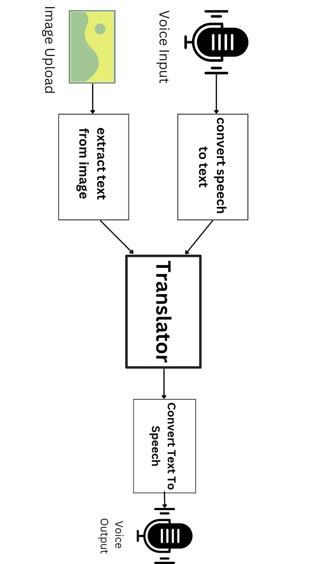
Proposed Method

Slide 6
Experiment Environment
Technology (or) Language : Python
Operating System : Windows
IDE : Visual Studio Code(VS Code)
LIBRARIES:
Speech Recognition
Tkinter
TextBlob
gTTs
Play Sound
PIL
pytesseract

Slide 7
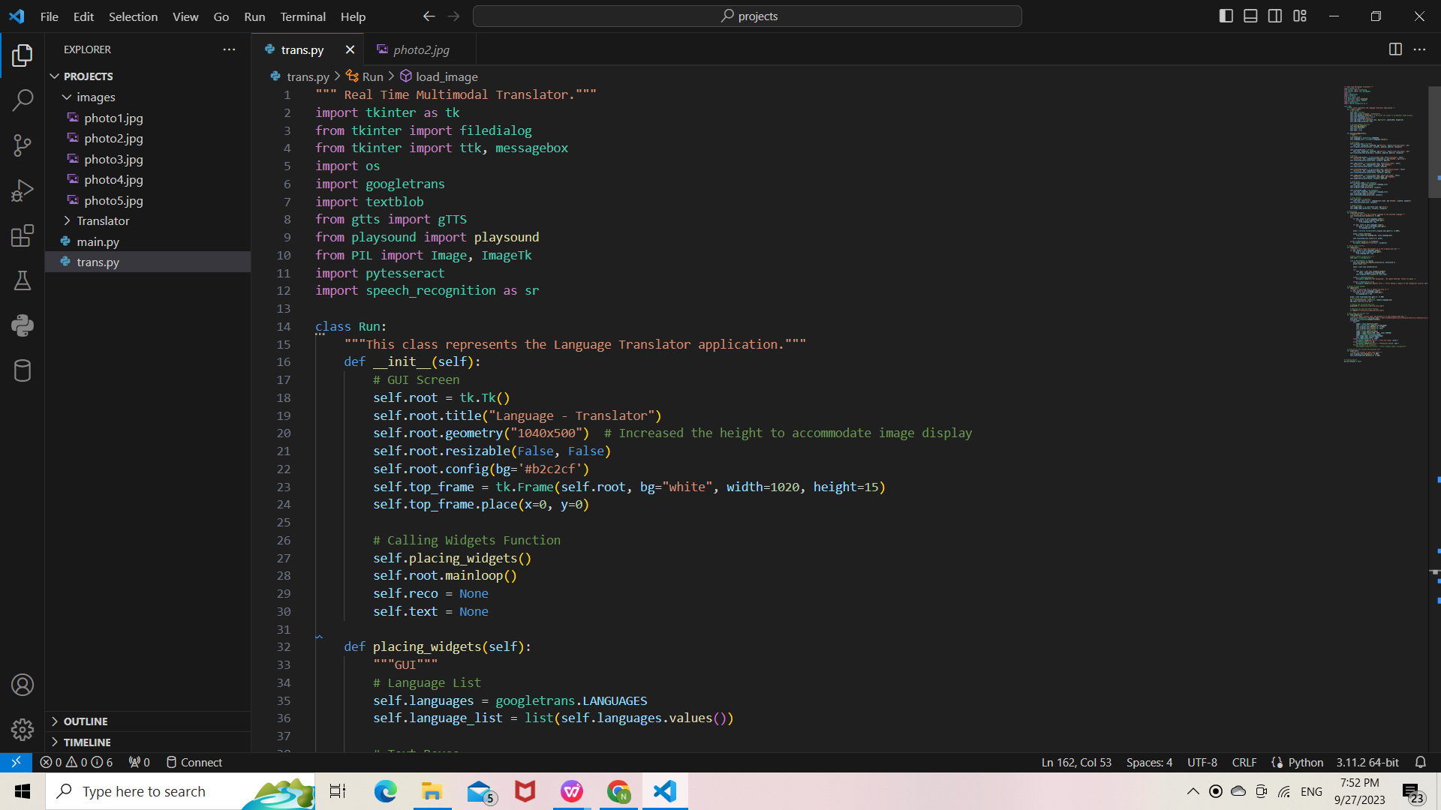
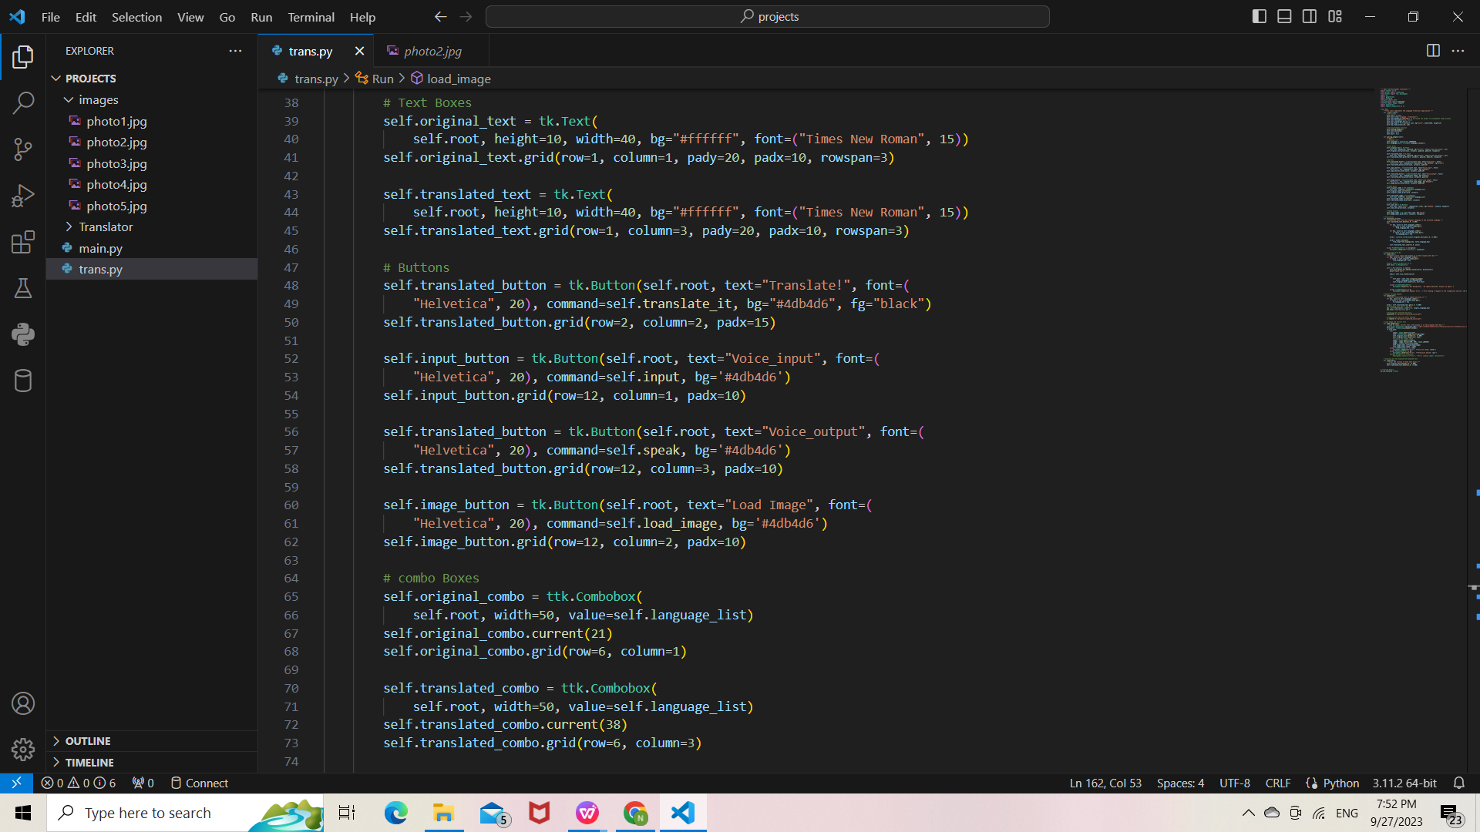
Experiment Screen shorts

Slide 8
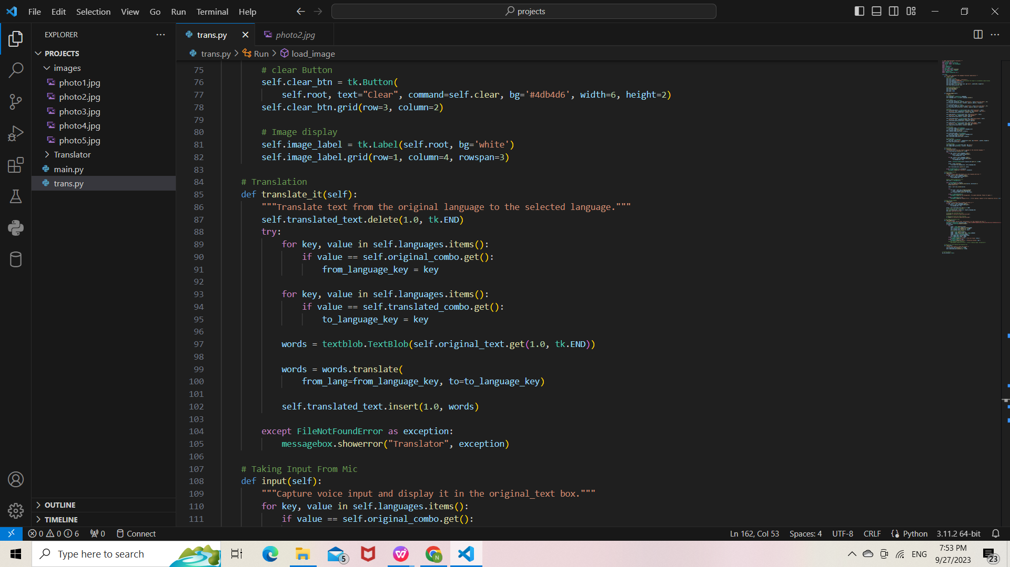
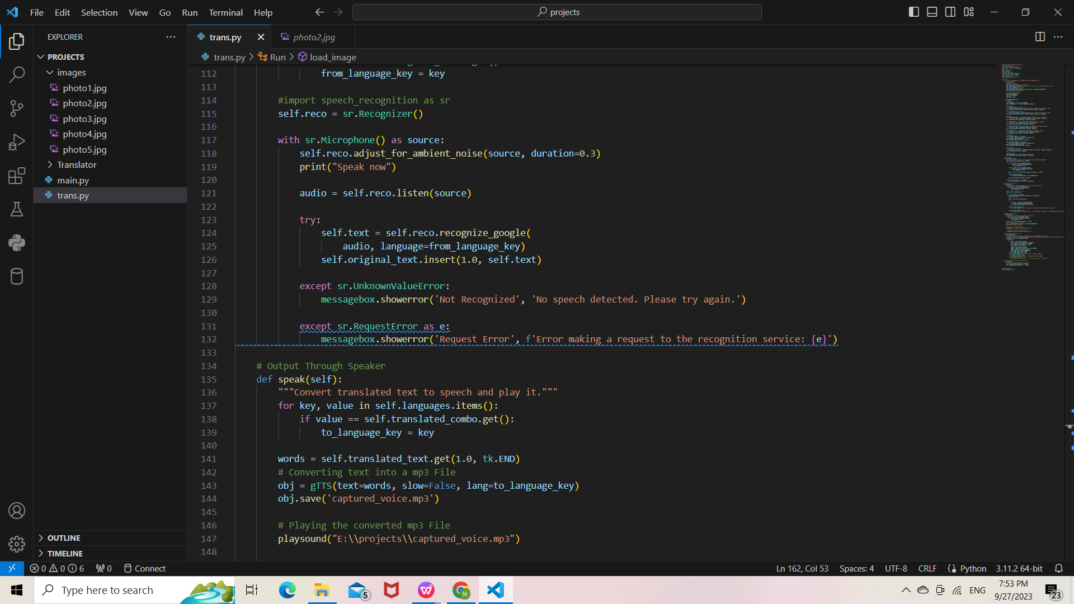
Experiment Screen shorts

Slide 9
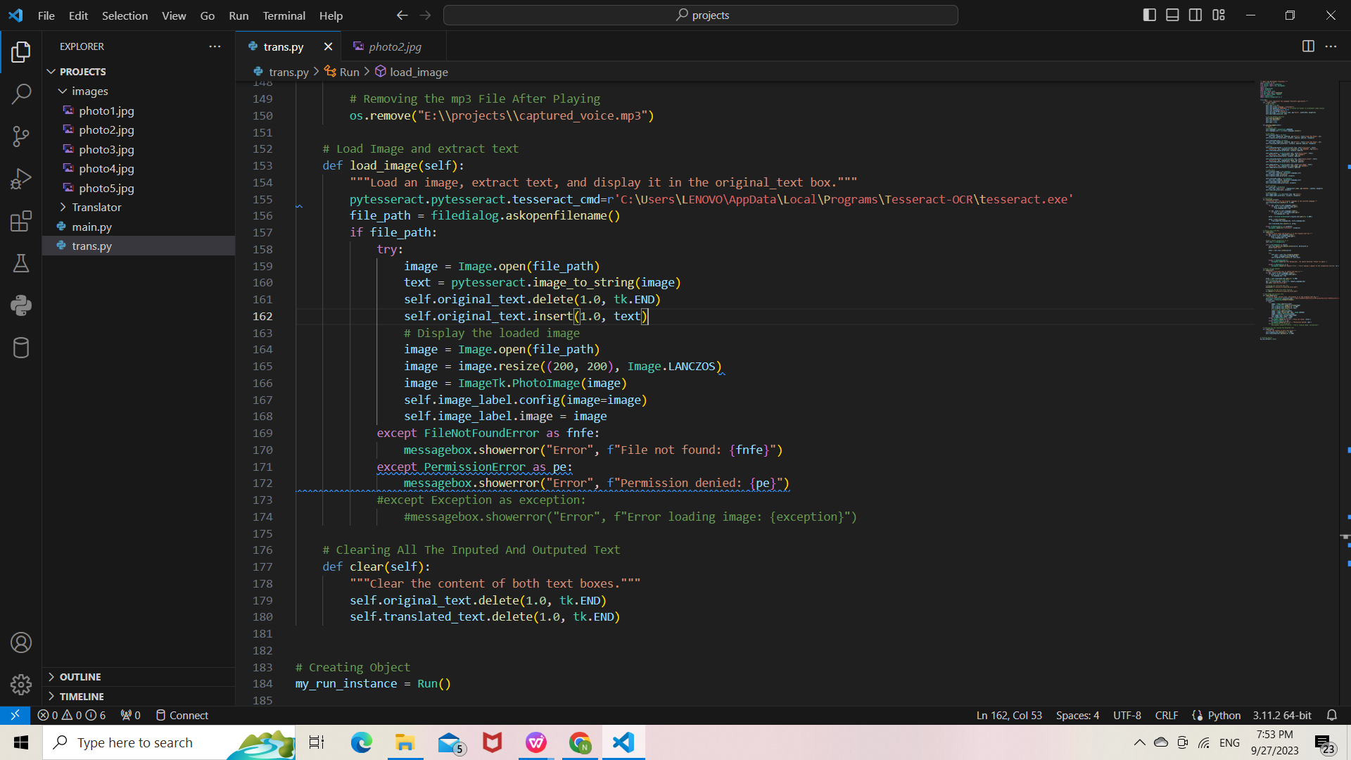
Experiment Screen shorts

Slide 10
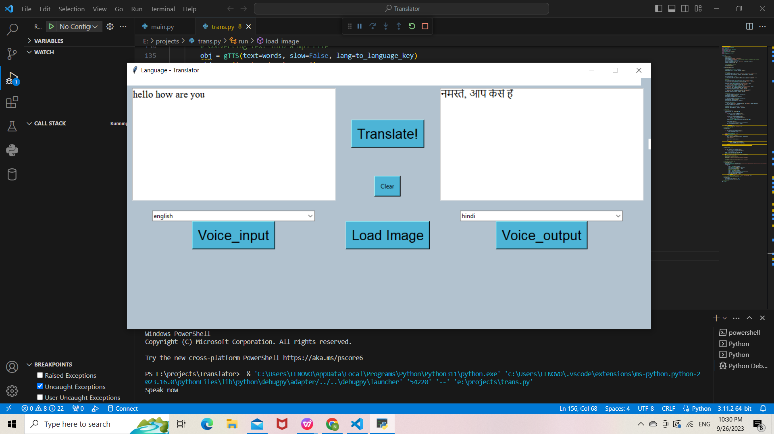
Experiment Results

Slide 11
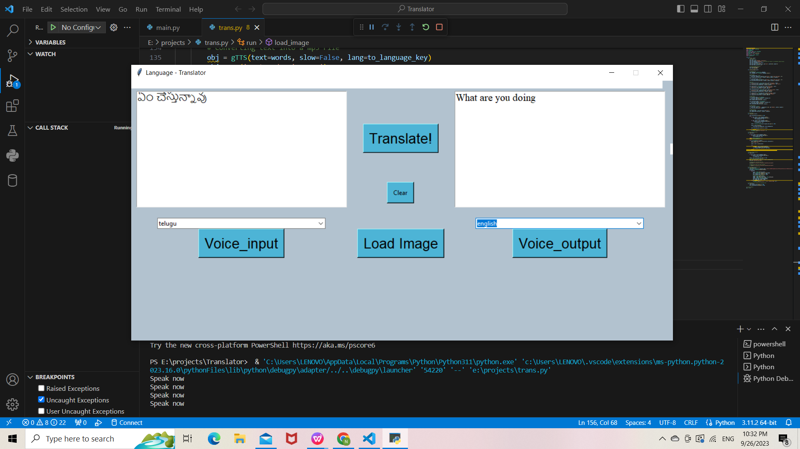
Experiment Results

Slide 12
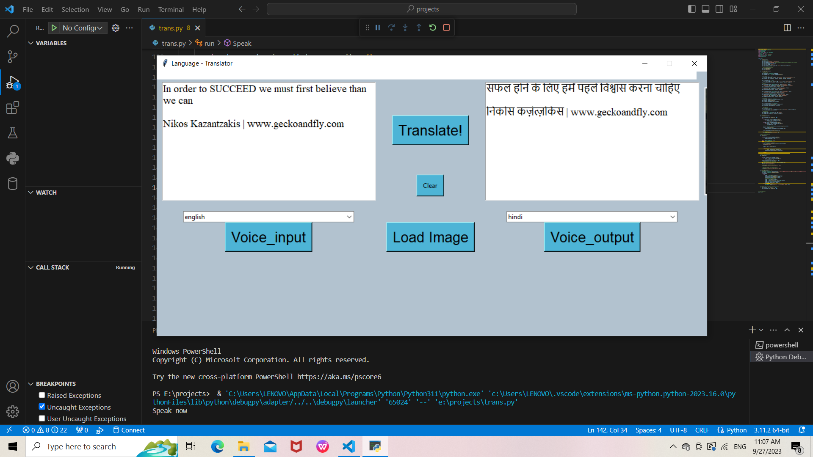
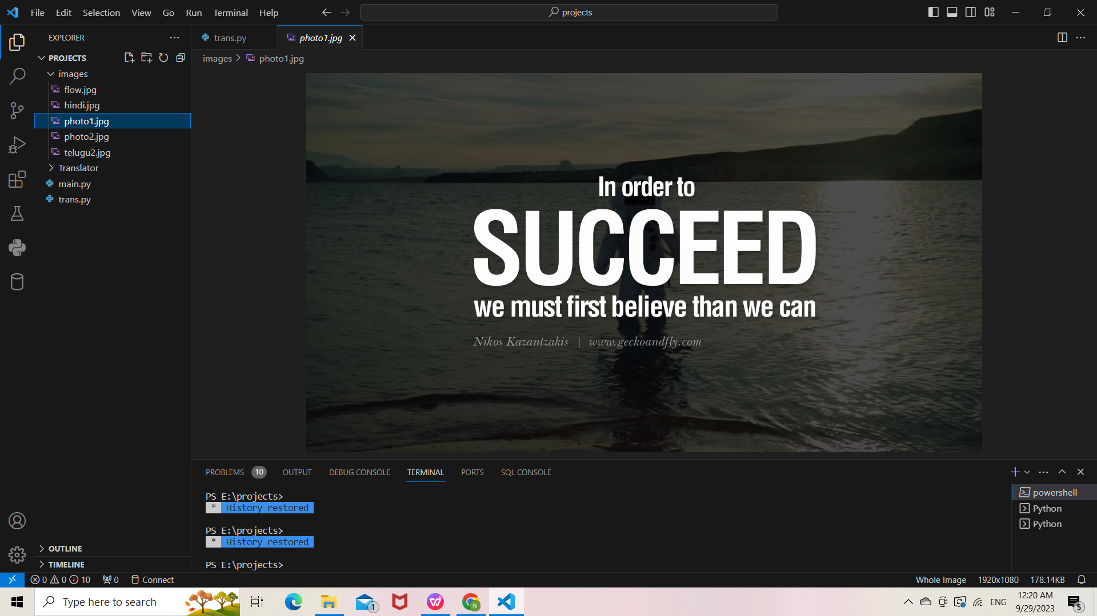
Experiment Results

Slide 13
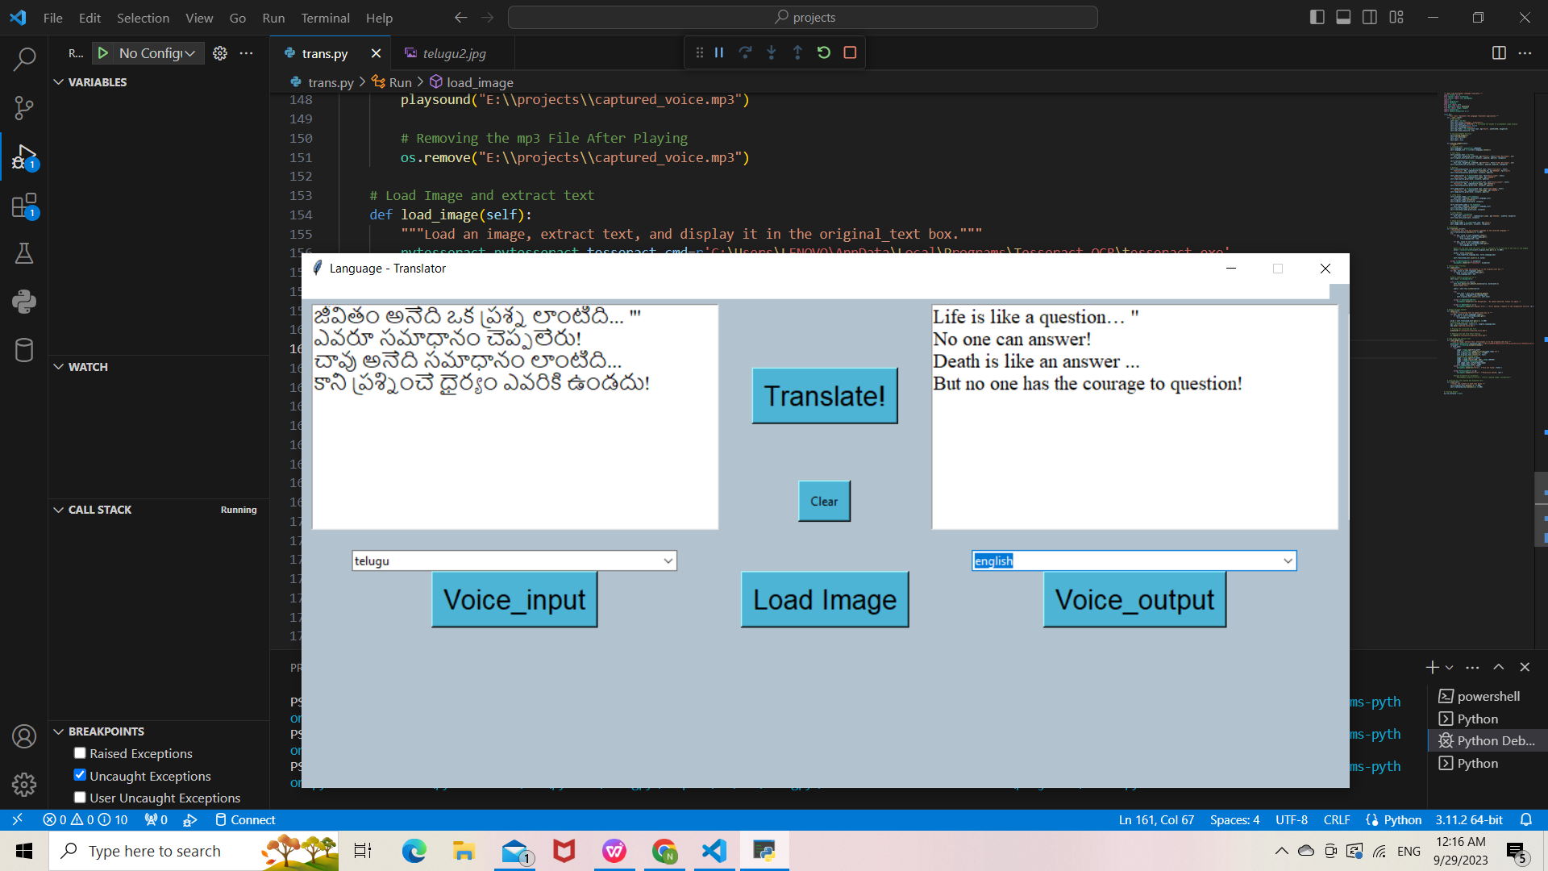
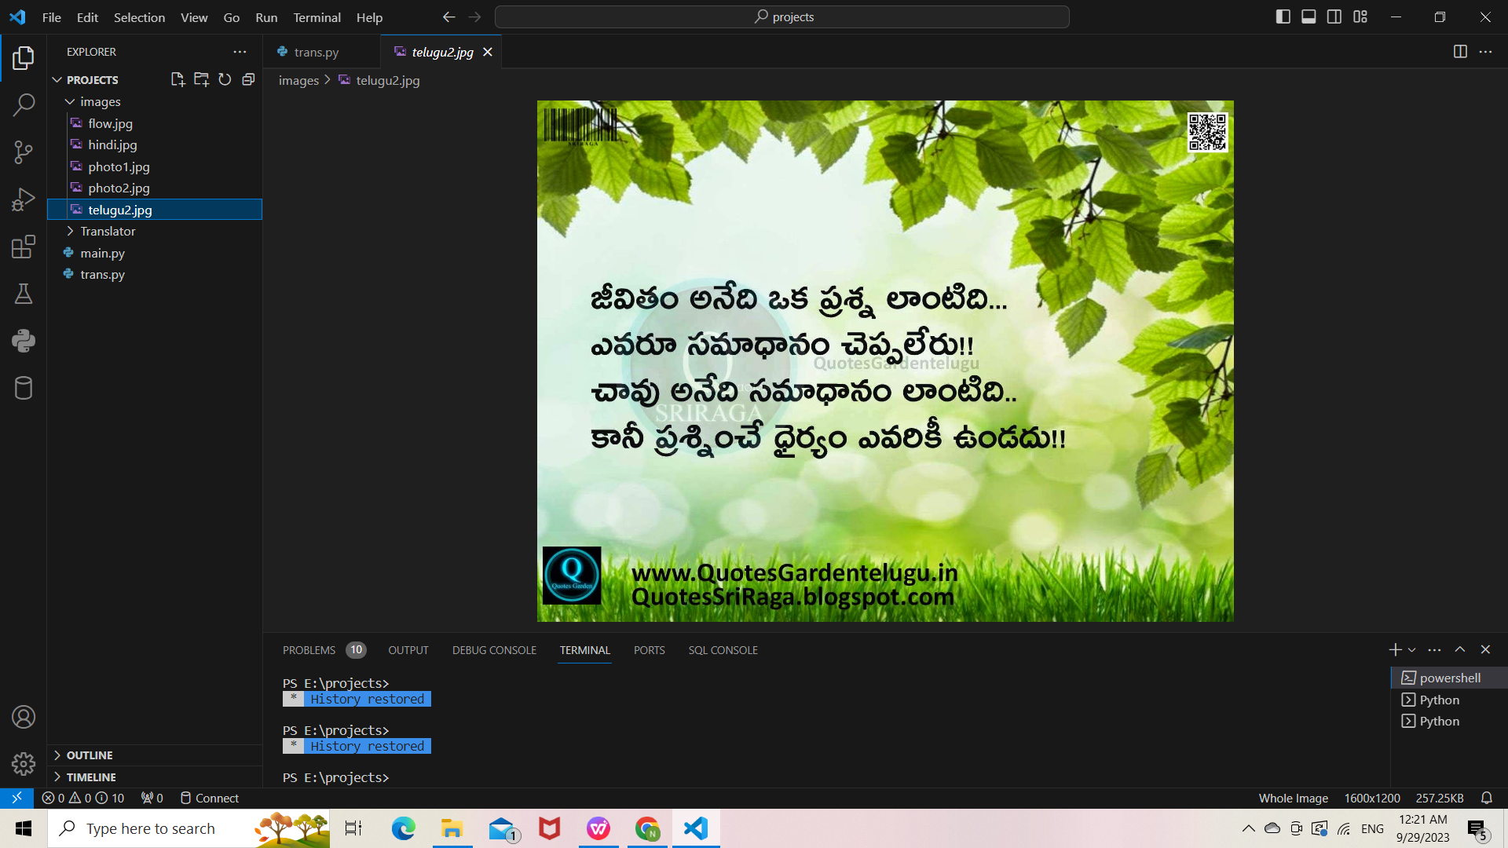
Experiment Results

Slide 14
Finding
The application provided appears to be an implementation of a real-time multimodal translator.The application allows users to perform various language-related tasks, including text translation, speech recognition, and text-to-speech conversion.
User-Friendly Interface:GUI Setup
Translation Functionality
Voice Input
Voice Output
Image Text Extraction
Language Options:Combo Boxes
Language Mapping
Overall, Application provides a user-friendly interface for performing various language-related tasks, making it suitable for a multimodal translation project or application.

Slide 15
Justification
Parameters Improved by This Method:
Translation Parameters:
from_language_key and to_language_key: These parameters determine the source and target languages for
translation.By selecting languages from combo boxes, users can specify the languages they want to translate
between.
Speech Recognition Parameters:
duration: This parameter adjusts for ambient noise during speech recognition, ensuring accurate voice input.
Text-to-Speech (TTS) Parameters:
slow: This parameter controls the speed of speech synthesis. It can be set to True or False to control the
speaking rate.
Image Text Extraction Parameters:
lang: This parameter specifies the language for text extraction from images using Tesseract OCR. In code.

